Slide 1
Education Committee

Slide 2
Education Committee
Helping the faculty with informing prospective students about IBC/CIW
(Virtual) Open Days
Student-For-A-Day
Study Choice Check Day
Notes:
Babylon aims to make a positive contribution to the student life of her members. Firstly, the association strives to function as a link between the business and student world. This is realised by organising several activities, where contact with the business world plays an important role. The purpose of these activities is to offer students the opportunity to gain knowledge in both theory and practice. Secondly, Babylon places great value on the development of amicable bonds/friendships that come into existence through organising and attending the activities arranged by the study association. In conclusion, the association aims to enrich the student life in the professional and social field.

Slide 3
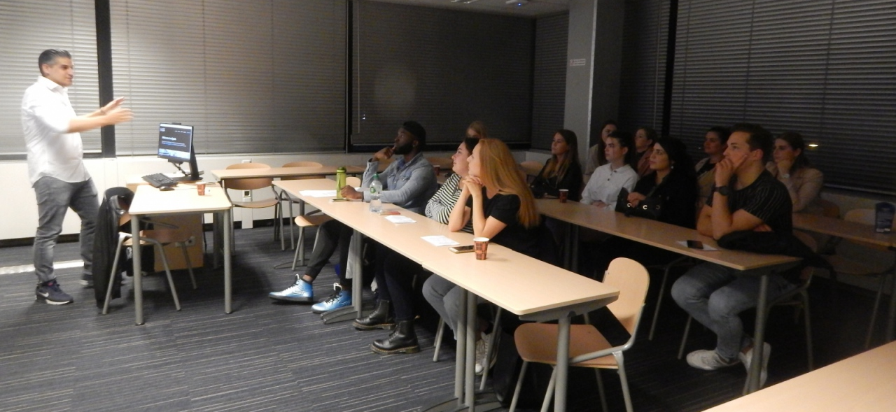
Education Committee
Organising events to help students orient themselves on career choices
CIS in the field
Notes:
Babylon aims to make a positive contribution to the student life of her members. Firstly, the association strives to function as a link between the business and student world. This is realised by organising several activities, where contact with the business world plays an important role. The purpose of these activities is to offer students the opportunity to gain knowledge in both theory and practice. Secondly, Babylon places great value on the development of amicable bonds/friendships that come into existence through organising and attending the activities arranged by the study association. In conclusion, the association aims to enrich the student life in the professional and social field.

Slide 4
Education Committee
Family Day
Notes:
Babylon aims to make a positive contribution to the student life of her members. Firstly, the association strives to function as a link between the business and student world. This is realised by organising several activities, where contact with the business world plays an important role. The purpose of these activities is to offer students the opportunity to gain knowledge in both theory and practice. Secondly, Babylon places great value on the development of amicable bonds/friendships that come into existence through organising and attending the activities arranged by the study association. In conclusion, the association aims to enrich the student life in the professional and social field.

