Slide 1
Prom Committee

Slide 2
Committee
Organise the prom
Photographer
DJ
Theme
Location: De Waagh
Notes:
Babylon aims to make a positive contribution to the student life of her members. Firstly, the association strives to function as a link between the business and student world. This is realised by organising several activities, where contact with the business world plays an important role. The purpose of these activities is to offer students the opportunity to gain knowledge in both theory and practice. Secondly, Babylon places great value on the development of amicable bonds/friendships that come into existence through organising and attending the activities arranged by the study association. In conclusion, the association aims to enrich the student life in the professional and social field.

Slide 3
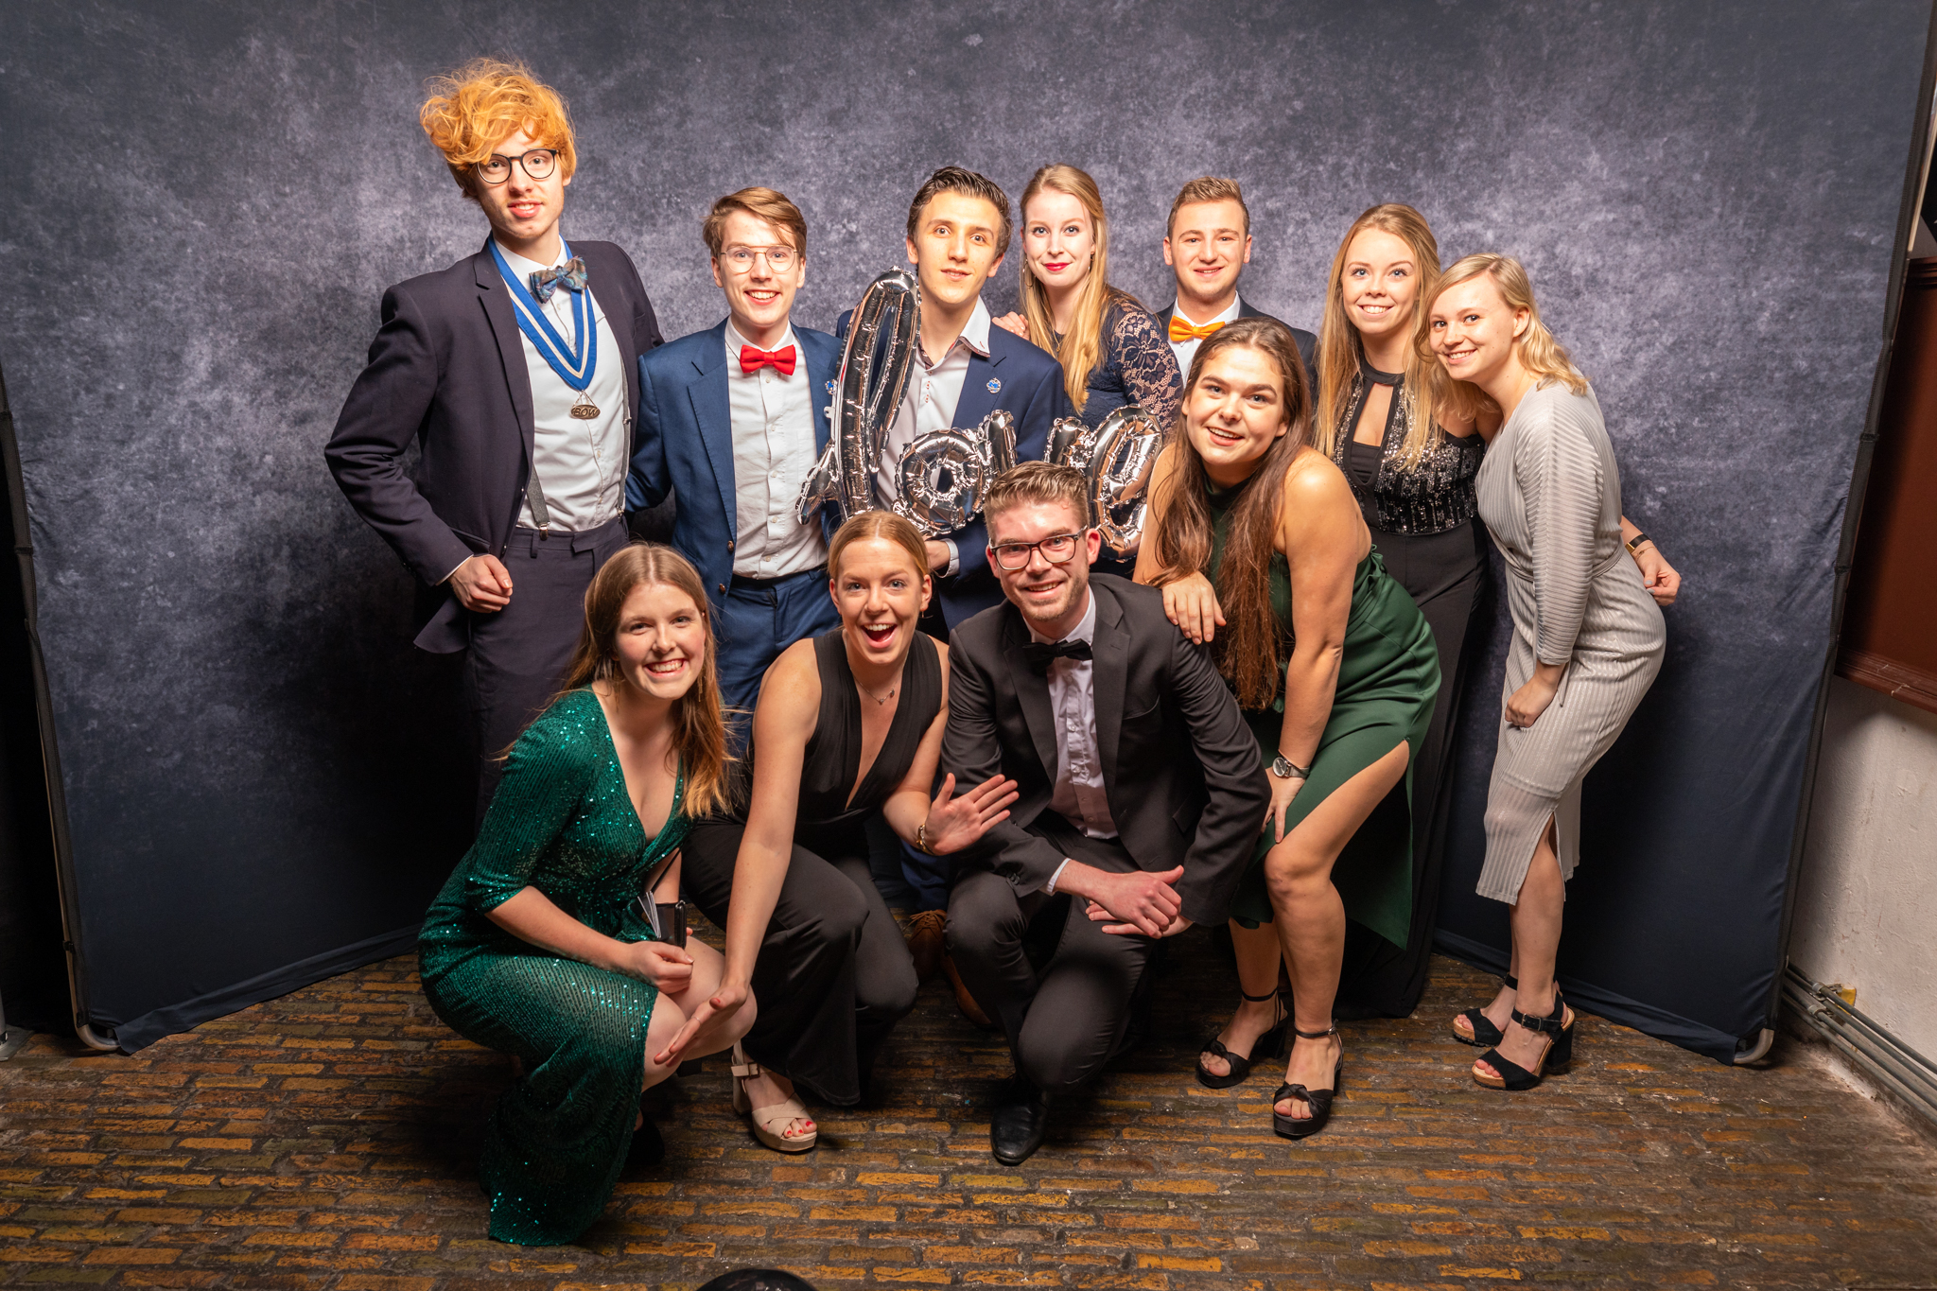
Pictures
Notes:
Babylon aims to make a positive contribution to the student life of her members. Firstly, the association strives to function as a link between the business and student world. This is realised by organising several activities, where contact with the business world plays an important role. The purpose of these activities is to offer students the opportunity to gain knowledge in both theory and practice. Secondly, Babylon places great value on the development of amicable bonds/friendships that come into existence through organising and attending the activities arranged by the study association. In conclusion, the association aims to enrich the student life in the professional and social field.

Slide 4
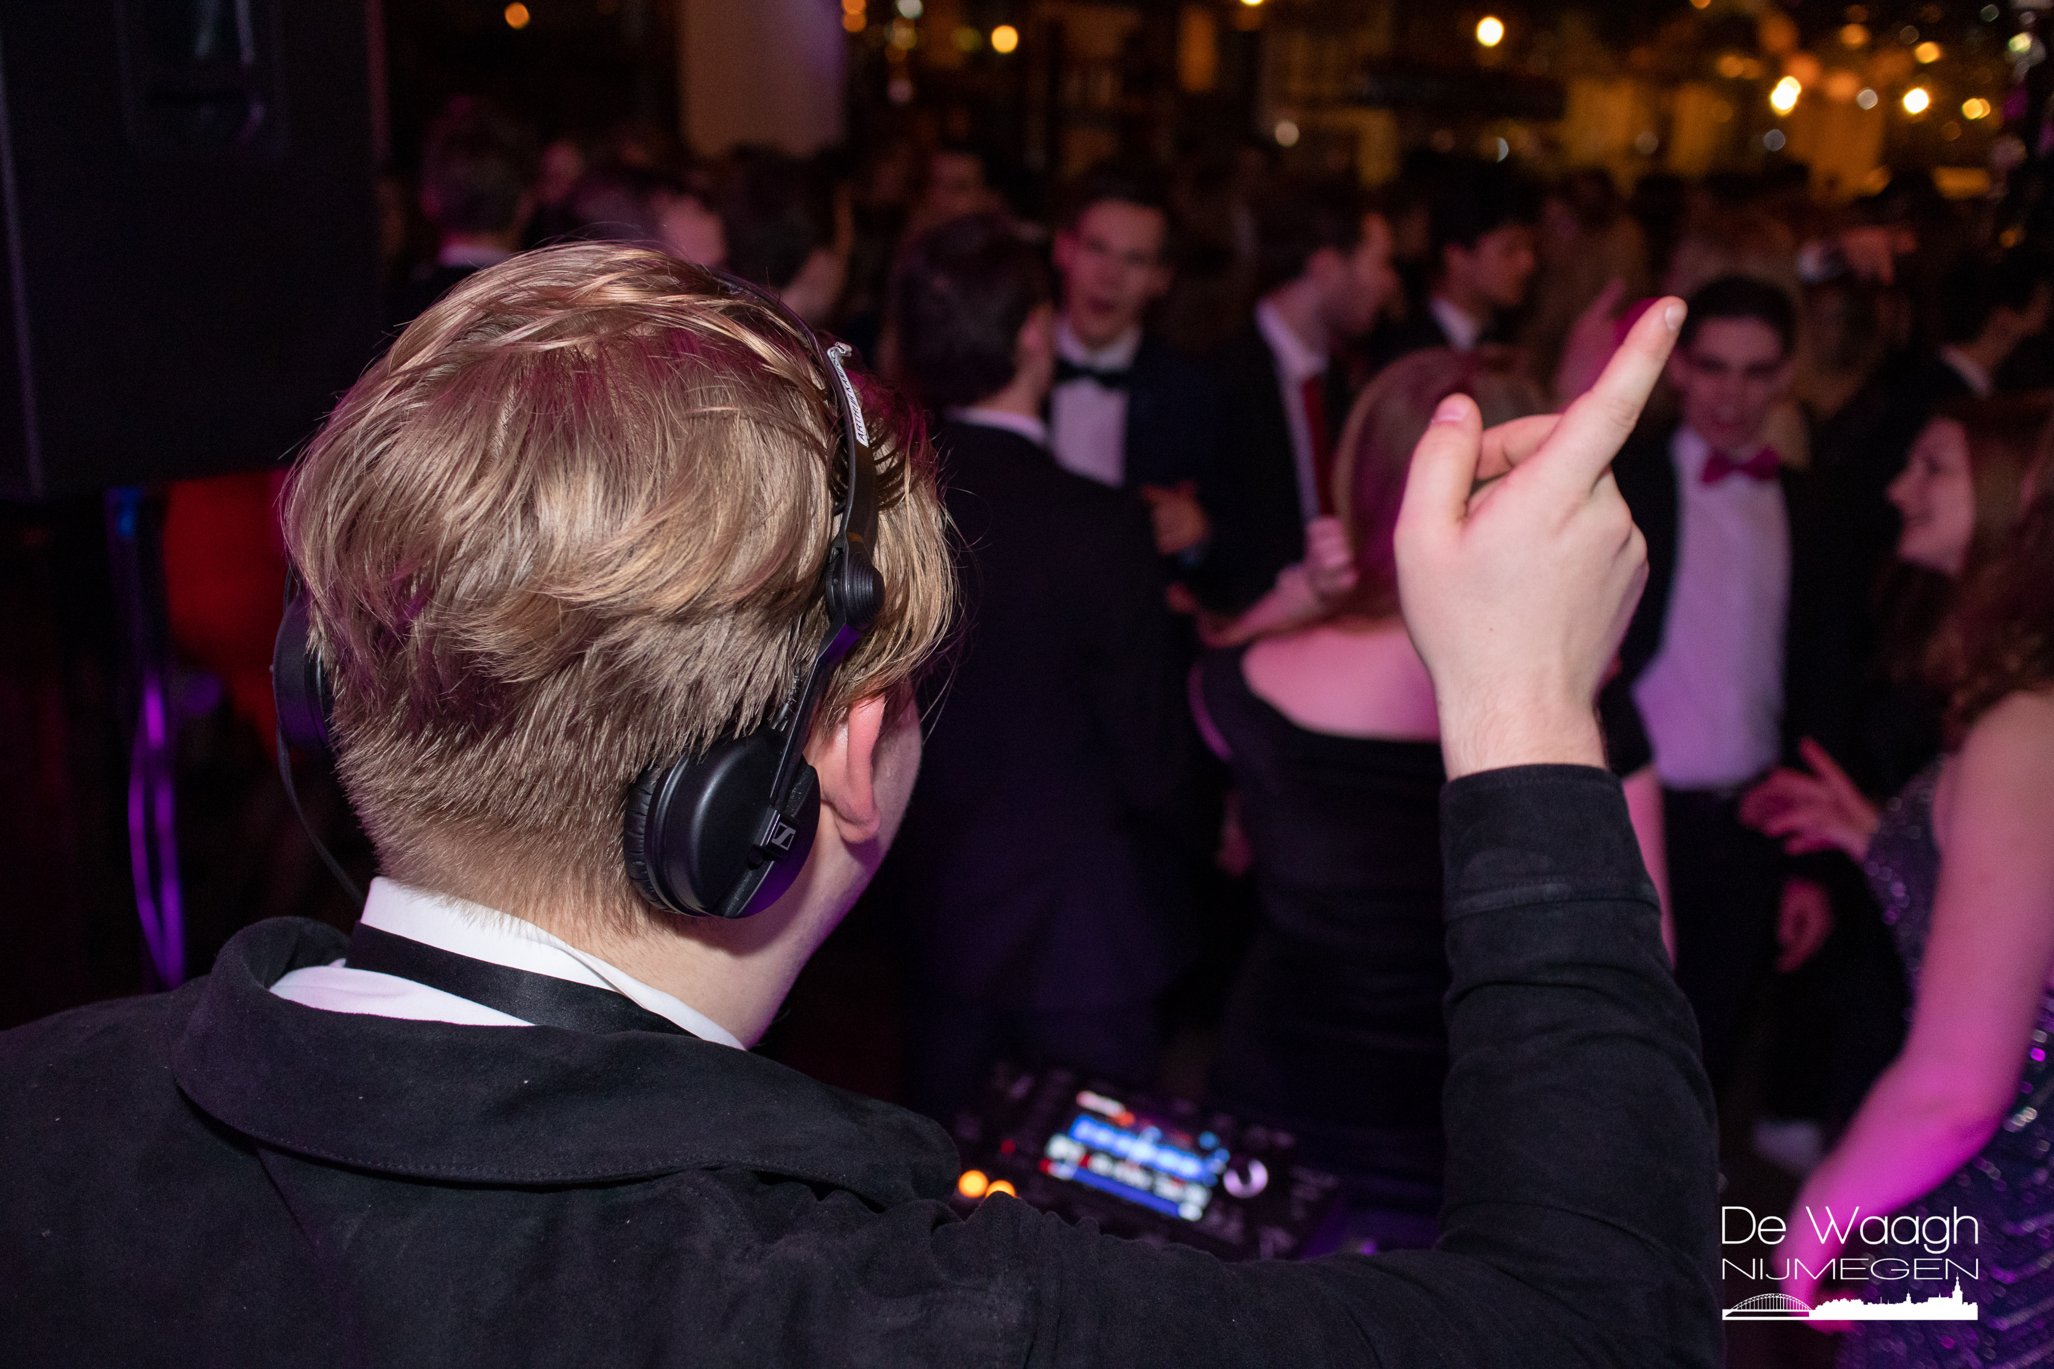
Pictures
Notes:
Babylon aims to make a positive contribution to the student life of her members. Firstly, the association strives to function as a link between the business and student world. This is realised by organising several activities, where contact with the business world plays an important role. The purpose of these activities is to offer students the opportunity to gain knowledge in both theory and practice. Secondly, Babylon places great value on the development of amicable bonds/friendships that come into existence through organising and attending the activities arranged by the study association. In conclusion, the association aims to enrich the student life in the professional and social field.

Slide 5
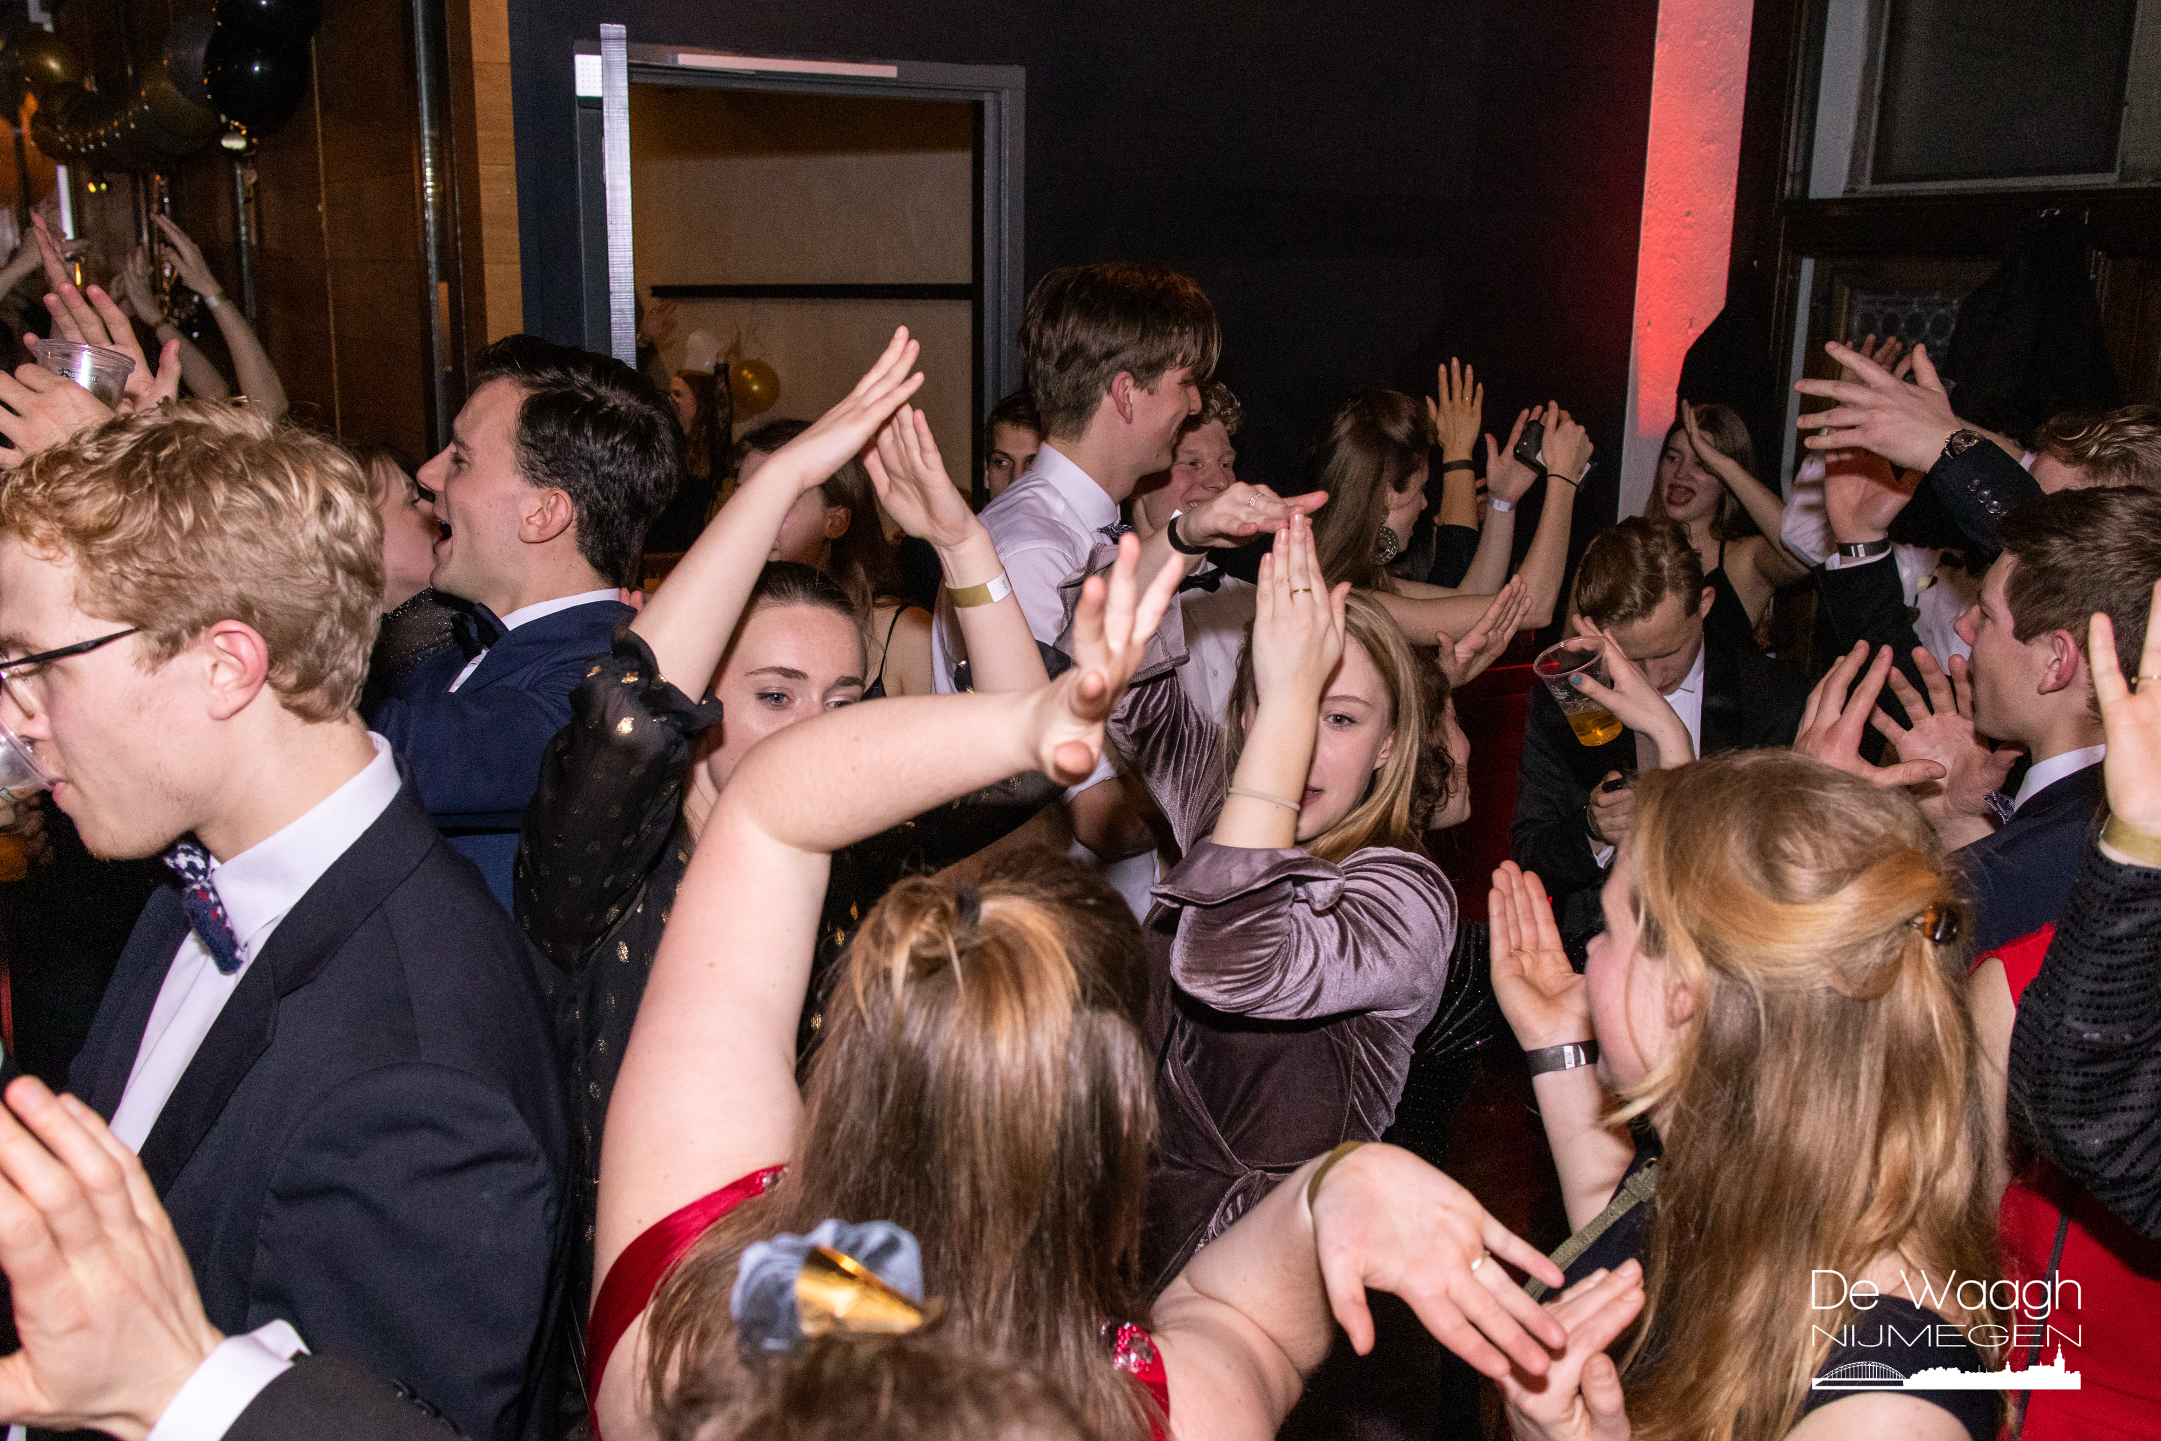
Pictures
Notes:
Babylon aims to make a positive contribution to the student life of her members. Firstly, the association strives to function as a link between the business and student world. This is realised by organising several activities, where contact with the business world plays an important role. The purpose of these activities is to offer students the opportunity to gain knowledge in both theory and practice. Secondly, Babylon places great value on the development of amicable bonds/friendships that come into existence through organising and attending the activities arranged by the study association. In conclusion, the association aims to enrich the student life in the professional and social field.

