Slide 1
Weekend Committee

Slide 2
Weekend Committee
Find a place to host the weekend at
Fix a means of transport to the location
Be in charge of all the activities during the weekend
Make sure everyone is having a good time!
Notes:
Babylon aims to make a positive contribution to the student life of her members. Firstly, the association strives to function as a link between the business and student world. This is realised by organising several activities, where contact with the business world plays an important role. The purpose of these activities is to offer students the opportunity to gain knowledge in both theory and practice. Secondly, Babylon places great value on the development of amicable bonds/friendships that come into existence through organising and attending the activities arranged by the study association. In conclusion, the association aims to enrich the student life in the professional and social field.

Slide 3
Weekend Committee
What kind of activities?
Is there a backup plan?
Notes:
Babylon aims to make a positive contribution to the student life of her members. Firstly, the association strives to function as a link between the business and student world. This is realised by organising several activities, where contact with the business world plays an important role. The purpose of these activities is to offer students the opportunity to gain knowledge in both theory and practice. Secondly, Babylon places great value on the development of amicable bonds/friendships that come into existence through organising and attending the activities arranged by the study association. In conclusion, the association aims to enrich the student life in the professional and social field.

Slide 4
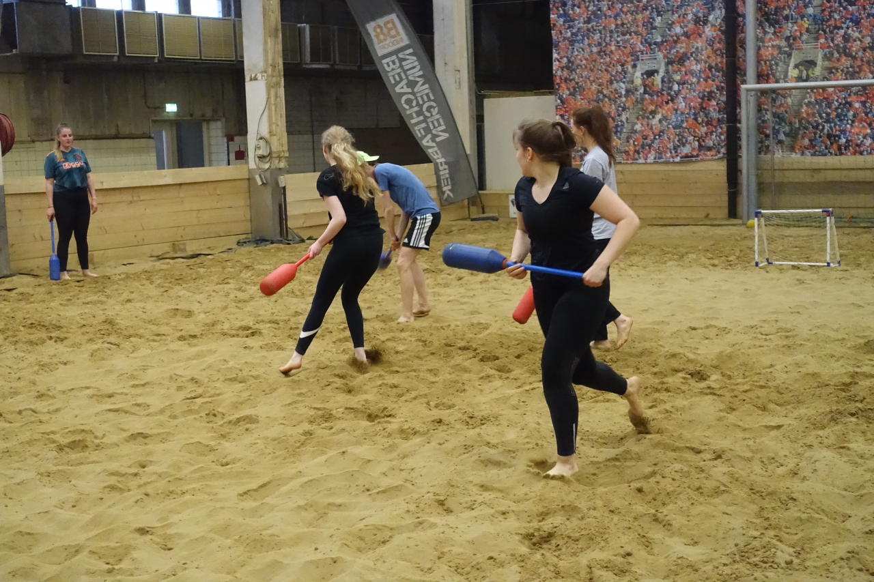
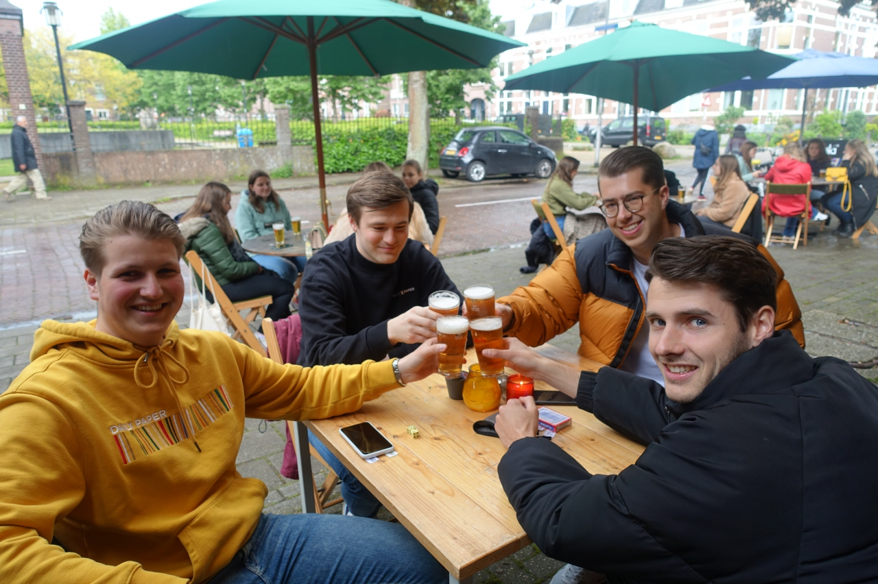
Pictures
Beach games!
Having a beer with the mates
Notes:
Babylon aims to make a positive contribution to the student life of her members. Firstly, the association strives to function as a link between the business and student world. This is realised by organising several activities, where contact with the business world plays an important role. The purpose of these activities is to offer students the opportunity to gain knowledge in both theory and practice. Secondly, Babylon places great value on the development of amicable bonds/friendships that come into existence through organising and attending the activities arranged by the study association. In conclusion, the association aims to enrich the student life in the professional and social field.

Slide 5
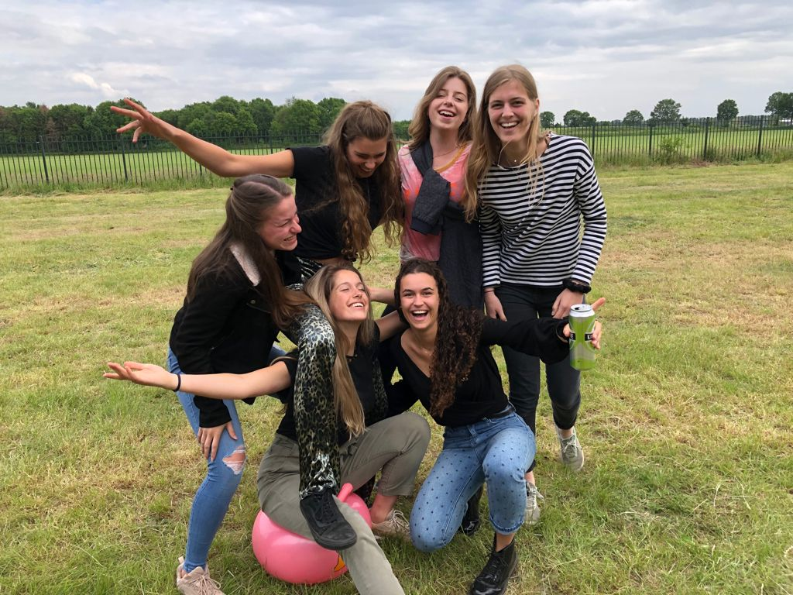
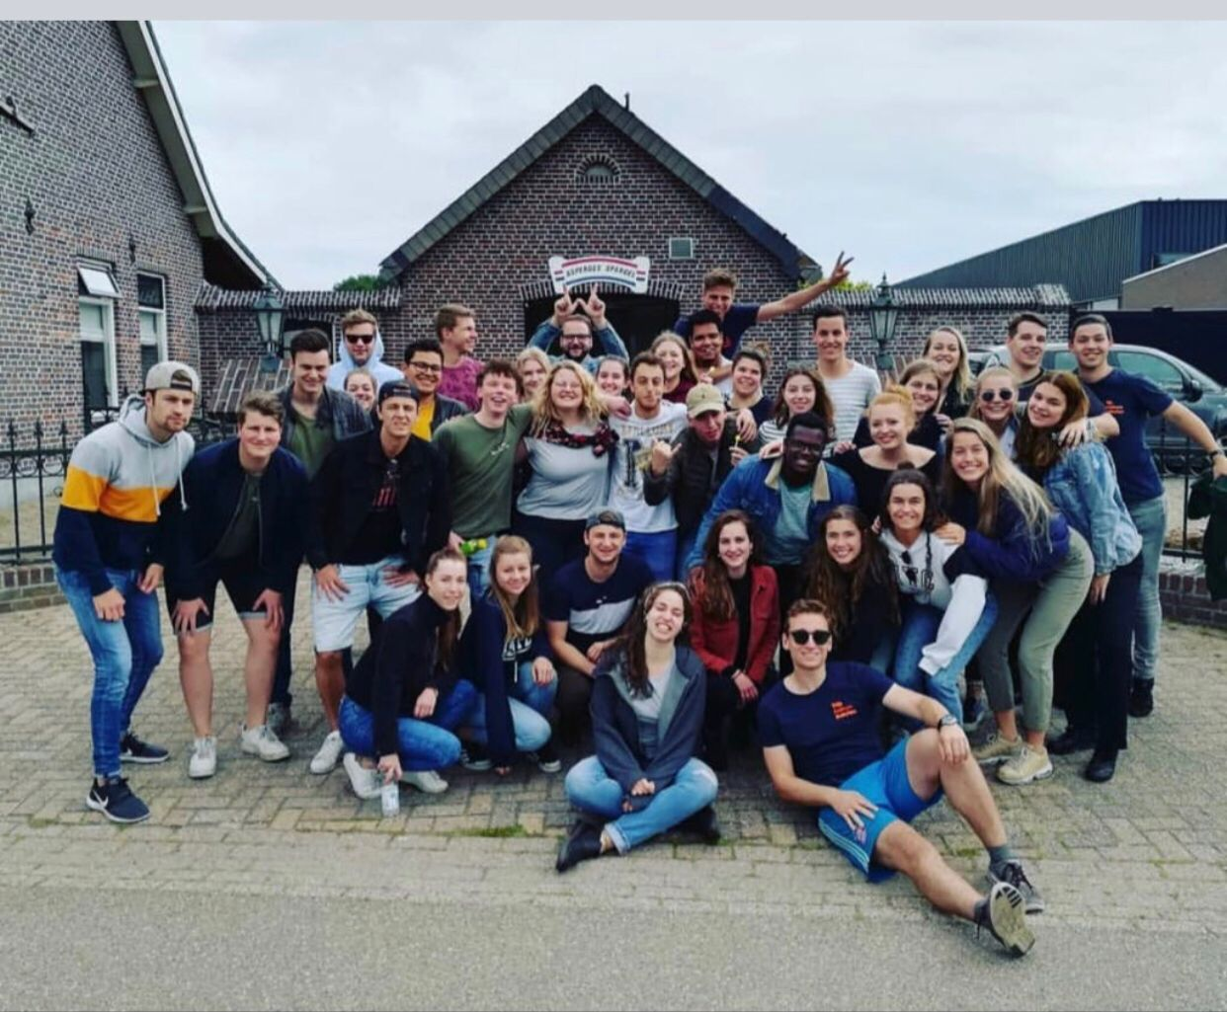
Pictures
Just bouncing through!
Group picture with the whole Babylon squad
Notes:
Babylon aims to make a positive contribution to the student life of her members. Firstly, the association strives to function as a link between the business and student world. This is realised by organising several activities, where contact with the business world plays an important role. The purpose of these activities is to offer students the opportunity to gain knowledge in both theory and practice. Secondly, Babylon places great value on the development of amicable bonds/friendships that come into existence through organising and attending the activities arranged by the study association. In conclusion, the association aims to enrich the student life in the professional and social field.

